Slide 1
Human Computer Interaction

Slide 2
Course Objectives
To gain an overview of Human-Computer Interaction(HCI), with an understanding of user interface design in general, and alternatives to traditional “keyboard & mouse” computing; become familiar with the vocabulary associated with sensory and cognitive systems as relevant to task performance by humans; be able to apply models from cognitive systems as relevant to task performance by humans;be able to apply models from cognitive psychology to predicting user performance in various human-computer interaction tasks & recognize the limits of human performance as they apply to computer operation; appreciate the importance of a design & evaluation methodology that begins with & maintains a focus on the user; be familiar with a variety of both conventional & non-traditional user interface paradigms, the latter including virtual & augumented reality, mobile & wearable computing, & ubiquitious computing & understand the social implications of technology & their ethical responsibilities as engineers in the design of technological systems. Finally, working in small groups on a product design from start to finish will provide you with invaluable team-work experience.

Slide 3
Course Outcomes
Ability to apply HCI & principles to interaction design
Ability to design certain tools for blind or PH people.

Slide 4
Topics
Introduction: Importance of user Interface
Definition
Importance of good design
Benefits of good design
A brief history of Screen design
The graphical user interface
Popularity of graphics
Concept of direct manipulation
Graphical system
Characteristics
Web user
Interface popularity
Principles of user interface

Slide 5
INTRODUCTION
Human–computer interaction (HCI), alternatively man–machine interaction (MMI) or computer–human interaction (CHI) is the study of interaction between people (users) and computers.
With today's technology and tools, and our motivation to create really effective and usable interfaces and screens, why do we continue to produce systems that are inefficient and confusing or, at worst, just plain unusable? Is it because:
1. We don't care?
2. We don't possess common sense?
3. We don't have the time?
4. We still don't know what really makes good design?

Slide 6
DEFINITION & GOALS
DEFINITION
"Human-computer interaction is a discipline concerned with the design, evaluation and implementation of interactive computing systems for human use and with the study of major phenomena surrounding them.“
GOALS
A basic goal of HCI is – to improve the interactions between users and computers – by making computers more usable and receptive to the user's needs.
A long term goal of HCI is – to design systems that minimize the barrier between the human's cognitive model of what they want – to accomplish and the computer's understanding of the user's task

Slide 7
WHY IS HCI IMPORTANT ?
User-centered design is getting a crucial role!
It is getting more important today to increase competitiveness via HCI studies (Norman, 1990)
High-cost e-transformation investments
Users lose time with badly designed products and services
Users even give up using bad interface – Ineffective allocation of resources

Slide 8
DEFINING THE USER INTERFACE
User interface, design is a subset of a field of study called human-computer interaction (HCI).
• Human-computer interaction is the study, planning, and design of how people and computers work together so that a person's needs are satisfied in the most effective way.
• HCI designers must consider a variety of factors:
– what people want and expect, physical limitations and abilities people possess,
--how information processing systems work,
– what people find enjoyable and attractive.
– Technical characteristics and limitations of the computer hardware and software must also be considered.

Slide 9
DEFINING THE USER INTERFACE
The user interface is to
– the part of a computer and its software that people can see, hear, touch, talk to, or otherwise understand or direct.
• The user interface has essentially two components: input and output.
• Input is how a person communicates his / her needs to the computer. – Some common input components are the keyboard, mouse, trackball, one's finger, and one's voice.
• Output is how the computer conveys the results of its computations and requirements to the user.
– Today, the most common computer output mechanism is the display screen, followed by mechanisms that take advantage of a person's auditory capabilities: voice and sound.

Slide 10
DEFINING THE USER INTERFACE
The use of the human senses of smell and touch output in interface design still remain largely unexplored.
• Proper interface design will provide a mix of well-designed input and output mechanisms that satisfy the user's needs, capabilities, and limitations in the most effective way possible.
• The best interface is one that it not noticed, one that permits the user to focus on the information and task at hand, not the mechanisms used to present the information and perform the task.

Slide 11
THE IMPORTANCE OF GOOD DESIGN
With today's technology and tools, and our motivation to create really effective and usable interfaces and screens, why do we continue to produce systems that are inefficient and confusing or, at worst, just plain unusable? Is it because:
• We don't care?
• We don't possess common sense?
• We don't have the time?
• We still don't know what really makes good design?
• But we never seem to have time to find out what makes good design, nor to properly apply it. After all, many of us have other things to do in addition to designing interfaces and screens.
• So we take our best shot given the workload and time constraints imposed upon us. The result, too often, is woefully inadequate.
• Interface and screen design were really a matter of common sense, we developers would have been producing almost identical screens for representing the real world.
• Example bad designs – Closed door with complete wood – suggestion : glass door

Slide 12
THE IMPORTANCE OF THE USER INTERFACE
• A well-designed interface and screen is terribly important to our users. It is their window to view the capabilities of the system.
• It is also the vehicle through which many critical tasks are presented. These tasks often have a direct impact on an organization's relations with its customers, and its profitability.
• A screen's layout and appearance affect a person in a variety of ways. If they are confusing and inefficient, people will have greater difficulty in doing their jobs and will make more mistakes.
• Poor design may even chase some people away from a system permanently. It can also lead to aggravation, frustration, and increased stress.

Slide 13
The Benefits of Good Design
• Poor clarity forced screen users to spend one extra second per screen.
– Almost one additional year would be required to process all screens. – Twenty extra seconds in screen usage time adds an additional 14 person years.
• The benefits of a well designed screen have also been under experimental scrutiny for many years.
– One researcher, for example, attempted to improve screen clarity and readability by making screens less crowded.
– Separate items, which had been combined on the same display line to conserve space, were placed on separate lines instead.
– The result screen users were about 20 percent more productive with the less crowded version.

Slide 14
The Benefits of Good Design
• Proper formatting of information on screens does have a significant positive effect on performance.
– In recent years, the productivity benefits of well-designed Web pages have also been scrutinized.
• Training costs are lowered because training time is reduced.
• support line costs are lowered because fewer assist calls are necessary.
• Employee satisfaction is increased because aggravation and frustration are reduced.
• Ultimately, that an organization's customers benefit because of the improved service they receive.
• Identifying and resolving problems during the design and development process also has significant economic benefits
• How many screens are used each day in our technological world?
• How many screens are used each day in your organization? Thousands? Millions?
• Imagine the possible savings. Proper screen design might also, of course, lower the costs of replacing "broken" PCs.

Slide 15
A BRIEF HISTORY OF THE HUMAN-COMPUTER INTERFACE
• The need for people to communicate with each other has existed since we first walked upon this planet.
• The lowest and most common level of communication modes we share are movements and gestures.
• Movements and gestures are language independent, that is, they permit people who do not speak the same language to deal with one another.
The next higher level, in terms of universality and complexity, is spoken language.
• Most people can speak one language, some two or more. A spoken language is a very efficient mode of communication if both parties to the communication understand it.
• At the third and highest level of complexity is written language. While most people speak, not all can write.
• But for those who can, writing is still nowhere near as efficient a means .of communication as speaking.
• In modem times, we have the typewriter, another step upward in communication complexity.
• Significantly fewer people type than write. (While a practiced typist can find typing faster and more efficient than handwriting, the unskilled may not find this the case.)

Slide 16
A BRIEF HISTORY OF THE HUMAN-COMPUTER INTERFACE
• Spoken language, however, is still more efficient than typing, regardless' of typing skill level.
• Through its first few decades, a computer's ability to deal with human communication was inversely related to what was easy for people to do.
-- The computer demanded rigid, typed input through a keyboard; people responded slowly using this device and with varying degrees of skill.
-- The human-computer dialog reflected the computer's preferences, consisting of one style or a combination of styles using keyboards, commonly referred to as Command Language, Question and Answer, Menu selection, Function Key Selection, and Form Fill-In.
• Throughout the computer's history, designers have been developing, with varying degrees of success, other human-computer interaction methods that utilize more general, widespread, and easier-to-learn capabilities: voice and handwriting.
--Systems that recognize human speech and handwriting now exist, although they still lack the universality and richness of typed input.

Slide 17
INTRODUCTION OF THE GRAPHICAL USER INTERFACE
• The Xerox systems, Altus and STAR, introduced the mouse and pointing and selecting as the primary human-computer communication method.
• The user simply pointed at the screen, using the mouse as an intermediary.
• These systems also introduced the graphical user interface as we know it a new concept was born, revolutionizing the human-computer interface.

Slide 18
A BRIEF HISTORY OF SCREEN DESIGN
While developers have been designing screens since a cathode ray tube display was first attached to a computer, more widespread interest in the application of good design principles to screens did not begin to emerge until the early 1970s, when IBM introduced its 3270 cathode ray tube text-based terminal.
A 1970s screen often resembled the one pictured in Figure. It usually consisted of many fields (more than are illustrated here) with very cryptic and often unintelligible captions.

Slide 19
A BRIEF HISTORY OF SCREEN DESIGN

Slide 20
A BRIEF HISTORY OF SCREEN DESIGN
It was visually cluttered, and often possessed a command field that challenged the user to remember what had to be keyed into it.
Ambiguous messages often required referral to a manual to interpret.
Effectively using this kind of screen required a great deal of practice and patience.
Most early screens were monochromatic, typically presenting green text on black backgrounds.
At the turn of the decade guidelines for text-based screen design were finally made widely available and many screens began to take on a much less cluttered look through concepts such as grouping and alignment of elements, as illustrated in Figure.
User memory was supported by providing clear and meaningful field captions and by listing commands on the screen, and enabling them to be applied, through function keys. Messages also became clearer.

Slide 21
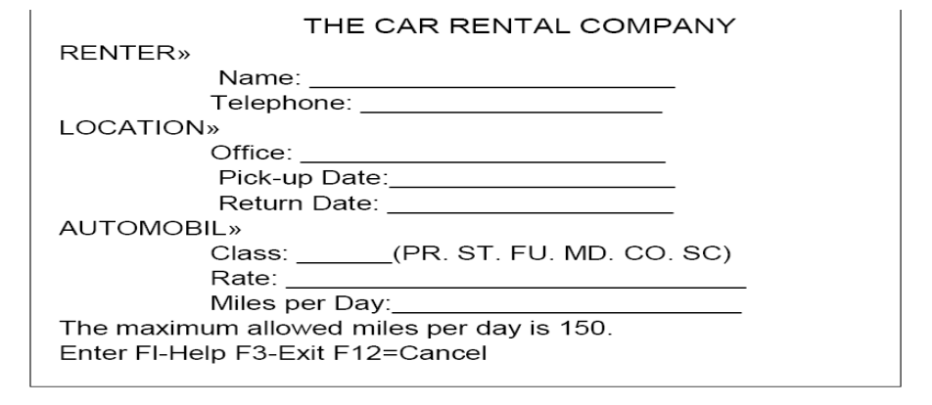
A BRIEF HISTORY OF SCREEN DESIGN

Slide 22
A BRIEF HISTORY OF SCREEN DESIGN

Slide 23
A BRIEF HISTORY OF SCREEN DESIGN
Multiple properties of elements were also provided, including many different font sizes and styles, line thicknesses, and colors.
The entry field was supplemented by a multitude of other kinds of controls, including list boxes, drop-down combination boxes, spin boxes, and so forth.
These new controls were much more effective in supporting a person's memory, now simply allowing for selection from a list instead of requiring a remembered key entry.
Completion aids disappeared from screens, replaced by one of the new listing controls. Screens could also be simplified, the much more powerful computers being able to quickly present a new screen.
In the 1990s, our knowledge concerning what makes effective screen design continued to expand. Coupled with ever-improving technology, the result was even greater improvements in the user-computer screen interface as the new century dawned.

Slide 24
THE POPULARITY OF GRAPHICS
A graphical screen bore scant resemblance to its earlier text-based colleagues.
Older text-based screen possessed a one dimensional
Graphic screens assumed a three-dimensional look.
Controls appeared to rise above the screen and move when activated.
Information could appear, and disappear, as needed.
Text could be replaced by graphical images called icons.
These icons could represent objects or actions
selection fields such as radio buttons, check boxes, list boxes, and palettes coexisted with the reliable old text entry field

Slide 25
GRAPHICAL SYSTEMS ADVANTAGES AND DISADVANTAGES
ADVANTAGES
• Symbols recognized faster than text
• Faster learning
• Faster use and problem solving
• Easier remembering
• More natural
• Exploits visual/spatial cues
• Fosters more concrete thinking

Slide 26
GRAPHICAL SYSTEMS ADVANTAGES AND DISADVANTAGES
DISADVANTAGES
• Greater design complexity.
• Learning still necessary
• Replaces national languages
• Easily augmented with text displays
• Smooth transition from command language system

Slide 27
THE CONCEPT OF DIRECT MANIPULATION
The system is portrayed as an extension of the real world: It is assumed that a person is already familiar with the objects and actions in his or her environment of interest.
The system simply replicates them and portrays them on a different medium, the screen.
A person has the power to access and modify these objects, among which are windows.
A person is allowed to work in a familiar environment and in a familiar way, focusing on the data, not the application and tools.
The physical organization of the system, which most often is unfamiliar, is hidden from view and is not a distraction.
Continuous visibility of objects and actions: Like one's desktop, objects are continuously visible. Reminders of actions to be performed are also obvious, labeled buttons replacing complex syntax and command names.

Slide 28
EARLIER DIRECT MANIPULATION SYSTEMS
The concept of direct manipulation actually preceded the first graphical system. The earliest full-screen text editors possessed similar characteristics.
Screens of text resembling a piece of paper on one's desk could be created (extension of real world) and then reviewed in their entirety (continuous visibility).
Editing or restructuring could be easily accomplished (through rapid incremental actions) and the results immediately seen.
Actions could be reversed when necessary. It took the advent of graphical systems to crystallize the direct manipulation concept, however.

Slide 29
INDIRECT MANIPULATION
In practice, direct manipulation of all screen objects and actions may not be feasible because of the following:
The operation may be difficult to conceptualize in the graphical system.
The graphics capability of the system may be limited.
The amount of space available for placing manipulation controls in the window border may be limited.
It may be difficult for people to learn and remember all the necessary operations and actions.
When this occurs, indirect manipulation is provided. Indirect manipulation substitutes words and text, such as pull-down or pop-up menus, for symbols, and substitutes typing for pointing.
Most window systems are a combination of both direct and indirect manipulation. A menu may be accessed by pointing at a menu icon and then selecting it (direct manipulation).

Slide 30
CHARACTERISTICS OF THE GRAPHICAL USER INTERFACE
A graphical system possesses a set of defining concepts. Included are sophisticated visual Presentation, pick-and click interaction, a restricted set of interface options, visualization, object orientation, extensive use of a person's recognition memory, and concurrent performance of functions.
Sophisticated Visual Presentation:
Visual presentation is the visual aspect of the interface. It is what people see on the screen.
The sophistication of a graphical system permits displaying lines, including drawings and icons.
It also permits the displaying of a variety of character fonts, including different sizes and styles.
The display of 16 million or more colors is possible on some screens. Graphics also permit animation and the presentation of photograph and motion video.

Slide 31
PRINCIPLES OF USER INTERFACE DESIGN
An interface must really be just an extension of a person. This means that the system and its software must reflect a person's capabilities and respond to his or her specific needs.
It should be useful, accomplishing some business objectives faster and more efficiently than the previously used method or tool did.
It must also be easy to learn, for people want to do, not learn to do.
Finally, the system must be easy and fun to use, evoking a sense of pleasure and accomplishment not tedium and frustration.
The interface itself should serve as both a connector and a separator
a connector in that it ties the user to the power of the computer, and a separator in that it minimizes the possibility of the participants damaging one another.
While the damage the user inflicts on the computer tends to be physical (a frustrated pounding of the keyboard), the damage caused by the computer is more psychological.

Slide 32
GENERAL PRINCIPLES
The design goals in creating a user interface are described below.
They are fundamental to the design and implementation of all effective interfaces, including GUI and Web ones.
These principles are general characteristics of the interface, and they apply to all aspects.
The compilation is presented alphabetically, and the ordering is not intended to imply degree of importance.

Slide 33
GENERAL PRINCIPLES
Aesthetically Pleasing
Provide visual appeal by following these presentation and graphic design principles:
Provide meaningful contrast between screen elements.
Create groupings.
Align screen elements and groups.
Provide three-dimensional representation.
Use color and graphics effectively and simply.
Clarity
The interface should be visually, conceptually, and linguistically clear, including
Visual elements
Functions
Metaphors
Words and Text

Slide 34
GENERAL PRINCIPLES
Compatibility
Provide compatibility with the following:
The user
- The task and job
- The Product
Adopt the User’s Perspective
Configurability
Permit easy personalization, configuration, and reconfiguration of settings.
Enhances a sense of control
Encourages an active role in understanding
Comprehensibility
A system should be easily learned and understood: A user should know the following: - What to look at - What to do - When to do it - Where to do it - Why to do it - How to do it

Slide 35
GENERAL PRINCIPLES
Consistency
A system should look, act, and operate the same throughout.
Similar components should:
Have a similar look.
Have similar uses.
Operate similarly.
• The same action should always yield the same result
• The function of elements should not change.
• The position of standard elements should not change.

Slide 36
OBSTACLES AND PITFALLS IN DEVELOPMENT PATH
No body ever gets it right for the first time
Development is chock full of surprises.
Good design requires living in a sea of changes.
Designers need good tools.
Performance design goals
People may make mistakes while using a good system also

Slide 37
COMMON PITFALLS
No early analysis and understanding the users needs and expectations.
A focus on using design features or components .
No usability testing.
No common design team vision.
Poor communication

Slide 38
COMMON USABILITY PROBLEMS
Ambiguous menus and icons.
Languages that permit only single direction movement through a system.
Input and direct manipulation limits.
Complex linkage.
Inadequate feedback.
Lack of system anticipation.
Inadequate error messages.

Slide 39
HUMAN INTERACTION WITH COMPUTERS
Understanding How People Interact with Computers Characteristics of computer systems, past and present, that have caused, and are causing, people problems.
We will then look at the effect these problems have –
Why people have trouble with computers
Responses to poor design
People and their tasks

Slide 40
PSYCHOLOGICAL
Typical psychological responses to poor design are:
Confusion: Detail overwhelms the perceived structure. Meaningful patterns are difficult to ascertain, and the conceptual model or underlying framework cannot be understood or established.
Annoyance: Roadblocks that prevent a task being completed, or a need from being satisfied, promptly and efficiently lead to annoyance. Inconsistencies in design,

Slide 41
PSYCHOLOGICAL
Frustration: An overabundance of annoyances, an inability to easily convey one's intentions to the computer, or an inability to finish a task or satisfy a need can cause frustration. Frustration is heightened if an unexpected computer response cannot be undone or if what really took place cannot be determined: Inflexible and unforgiving systems are a major source of frustration.
Panic or stress: Unexpectedly long delays during times of severe or unusual pressure may introduce panic or stress. Some typical causes are unavailable systems or long response times when the user is operating under a deadline or dealing with an irate customer.
Boredom: Boredom results from improper computer pacing (slow response times or long download times) or overly simplistic jobs.

Slide 42
IMPORTANT HUMAN CHARACTERISTICS IN DESIGN
Importance in design are perception, memory, visual acuity, foveal and peripheral vision, sensory storage, information processing, learning, skill, and individual differences.
Perception
Proximity
Similarity
Matching patterns
Succinctness
Closure
Unity
Continuity

Slide 43
IMPORTANT HUMAN CHARACTERISTICS IN DESIGN
Memory: Memory is not the most stable of human attributes, as anyone who has forgotten why they walked into a room, or forgotten a very important birthday, can attest.
-Short-term, or working, memory.
Long-term memory
Mighty memory

Slide 44
IMPORTANT HUMAN CHARACTERISTICS IN DESIGN
Mental Models: As a result of our experiences and culture, we develop mental models of things and people we interact with.
A mental model is simply an internal representation of a person's current understanding of something. Usually a person cannot describe this mental mode and most often is unaware it even exists.
Mental models are gradually developed in order to understand something, explain things, make decisions, do something, or interact with another person.
Mental models also enable a person to predict the actions necessary to do things if the action has been forgotten or has not yet been encountered.
Movement Control : Once data has been perceived and an appropriate action decided upon, a response must be made.

Slide 45
THE IMPLICATIONS IN SCREEN DESIGN
Learning: Learning, as has been said, is the process of encoding inlong-term memory information that is contained in short-term memory.
It is a complex process requiring some effort on our part. Our ability to learn is important-it clearly differentiates people from machines.
Given enough time people can improve the performance in almost any task. Too often, however, designers use our learning ability as an excuse to justify complex design.
A design developed to minimize human learning time can greatly accelerate human performance.
People prefer to stick with what they know, and they prefer to jump in and get started. Unproductive time spent learning is something frequently avoided.
Skill: The goal of human performance is to perform skillfully. To do so requires linking inputs and responses into a sequence of action.

Slide 46
HUMAN CONSIDERATIONS IN DESIGN
The User's Knowledge and Experience The knowledge possessed by a person, and the experiences undergone, shape the design of the interface in many ways.
The following kinds of knowledge and experiences should be identified.
Computer Literacy - Highly technical or experienced, moderate computer experience, or none
System Experience - High, moderate, or low knowledge of a particular system and its methods of interaction
Application Experience - High, moderate, or low knowledge of similar systems

Slide 47
HUMAN CONSIDERATIONS IN DESIGN
Task Experience - Other Level of knowledge of job and job tasks
Systems Use - Frequent or infrequent use of other systems in doing job
Education - High school, college, or advanced degree
Reading Level - Less than 5th grade, 5th-12th, more than 12th grade
Typing Skill - Expert (135 WPM), skilled (90 WPM), good (55 WPM), average (40 WPM), or "hunt and peck" (10 WPM).
Native Language or Culture- English, another, or several.

Slide 48
JOB/TASK/NEED
Type of System Use - Mandatory or discretionary use of the system.
• Frequency of Use - Continual, frequent, occasional, or once-in-a-lifetime use of system
• Task or Need importance - High, moderate, or low importance of the task being performed
• Task Structure - Repetitiveness or predictability of tasks being automated, high, moderate, or low
• Social Interactions - Verbal communication with another person required or not required
• Primary Training - Extensive or formal training, self training through manuals, or no training
• Turnover Rate - High, moderate, or low turnover rate for jobholders
• Job Category - Executive, manager, professional, secretary, clerk
• Lifestyle - For Web e-commerce systems, includes hobbies, recreational pursuits, and economic status

Slide 50
HUMAN INTERACTION SPEEDS
The speed at which people can perform using various communication methods has been studied by a number of researchers.
• Reading: The average adult, reading English prose in the United States, has a reading speed in the order of 250-300 words per minute. Proof reading text on paper has been found to occur at about 200 words per minute, on a computer monitor, about 180 words per minute.
• One technique that has dramatically increased reading speeds is called Rapid Serial Visual Presentation, or RSVP. In this technique single words are presented one at a time in the center of a screen. New words continually replace old words at a rate set by the reader. For a sample of people whose paper document reading speed was 342 words per minute. (With a speed range of 143 to 540 words per minute.) Single words were presented on a screen in sets at a speed sequentially varying ranging from 600 to 1,600 words per minute. After each set a comprehension test was administered.

Slide 51
UNDERSTAND THE BUSINESS FUNCTION
Business definition and requirements analysis
--Direct methods
--Indirect methods
--Requirements collection guidelines
• Determining basic business functions
--Developing conceptual modes
--Understanding mental models
--Users new mental model
• Design standards or style guides
--Value of standards and guidelines
--Document design
--Design support and implementation

Slide 52
DIRECT METHODS
Individual Face-to-Face Interview
• Telephone Interview or Survey
• Traditional Focus Group
• Facilitated Team Workshop
• Observational Field Study
• User-Interface Prototyping
• Usability Laboratory Testing
• Card Sorting for Web Sites
• A technique to establish groupings of information for Web sites

Slide 53
INDIRECT METHODS
• MIS Intermediary
• Paper Surveyor Questionnaire
• Electronic Surveyor Questionnaire
• Electronic Focus Group
• Marketing and Sales
• Support Line
• E-Mail or Bulletin Board
• User Group
• Competitor Analyses
• Trade Show
• Other Media Analysis
• System Testing

Slide 54
DETERMINING BASIC BUSINESS FUNCTIONS
• Major system functions are listed and described, including critical system inputs and outputs.
A flowchart of major functions is developed. The process the developer will use is summarized as follows:
Gain a complete understanding of the user's mental model based upon:
• The user's needs and the user's profile.
• A user task analysis.
• Develop a conceptual model of the system based upon the user's mental model.
This includes: • Defining objects. • Developing metaphors.

Slide 55
UNDERSTANDING THE USER'S MENTAL MODEL
The next phase in interface design is to thoroughly describe the expected system user or users and their current tasks.
• The former will be derived from the kinds of information collected in Step 1 "Understand the User or Client," and the requirements analysis techniques described above.
• A goal of task analysis, and a goal of understanding the user, is to gain a picture of the user's mental model.
• A mental model is an internal representation of a person's current conceptualization and understanding of something.
• Mental models are gradually developed in order to understand, explain, and do something.

Slide 56
DEVELOPING CONCEPTUAL MODELS
Since mental models are influenced by a person’s experiences, and people have different experiences, no two user mental models are likely to be exactly the same.
• Each person looks at the interface from a slightly different perspective. The goal of the designer is to facilitate for the user the development of useful mental model of the system.
• This is accomplished by presenting to the user a meaningful conceptual model of the system .
• When the user then encounters the system, his or her existing mental model will, hopefully, mesh well with the system's conceptual model.
• As a person works with a system, he or she then develops a mental model of the system.
• The system mental model the user derives is based upon system's behavior, including factors such as the system inputs, actions, outputs (including screens and messages), and its feedback and guidance characteristics, all of which are components of the conceptual model.

Slide 57
SCREEN DESIGNING
How to distract the screen user
• Unclear captions
• Improper type and graphic emphasis
• Misleading headings
• Irrelevant and unnecessary headings
• Inefficient results
• Clustered and cramped layout
Variety of distractions
• Numerous audio and visual interruptions
• Extensive visual clutter
• Poor information readability
• In comprehensible screen components
• Confusing and inefficient navigation • Inefficient operations • Excessive or inefficient page scrolling • Information overload • Design in consistenc

Slide 58
SCREEN MEANING AND PURPOSE
Each screen element
• Every control
• All text
• Screen organization
• All emphasis
• Each color
• Every graphic
• All screen animation
• All forms of feedback
Must
• Have meaning to screen users
• Serve a purpose in performing task organizing screen elements

Slide 59
ORDERING OF SCREEN DATA & CONTENT
Form groups that cover all possibilities.
Ensure that information is visible.
Ensure that only information relative to task is presented on screen.
Organizational scheme is to minimize number of information variables.
Upper left starting point
Provide an obvious starting point in the screen’s upper left Corner.

Slide 61
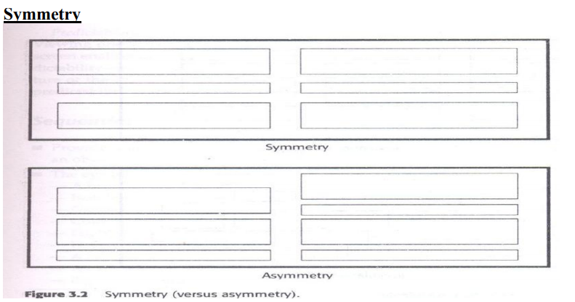

Slide 62
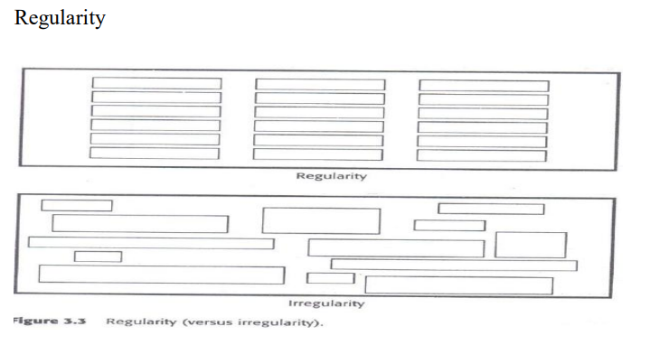

Slide 63
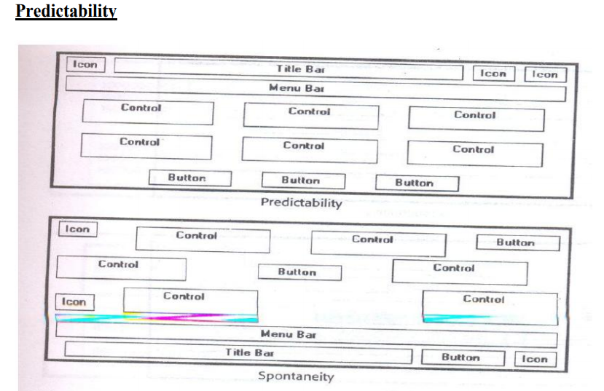

Slide 64
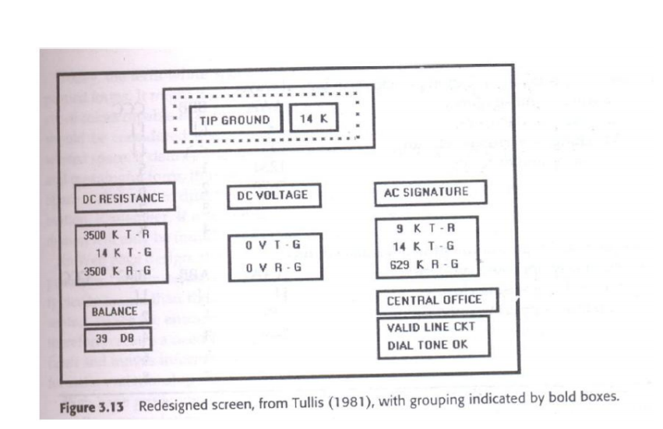

Slide 65
TECHNOLOGICAL CONSIDERATION -INTERFACE DESIGN
Graphical systems
Screen design must be compatible with the capabilities of the system • system power
• Screen size
• Screen resolution
• Display colors
• Other display features
• Screen design must be compatible with the capabilities of the
• Platform compatibility
• development and implementation
• Platform style guide
• Browser
• compatibility
• monitor size and resolution • fonts • Color • Bandwidth • Version

Slide 66
Windows-News & Navigation schemes selection of window
A window is an area of the screen that contains a particular view of some area of the computer or some portion of a person’s dialog with the computer.
Content
• A window’s characteristics
• A window’s components
• A window’s presentation styles
• The types of windows available
• Organizing window system functions
• A window’s operations
• Web system frames and pop-up windows

Slide 67
Windows-News & Navigation schemes selection of window
Window Characteristics
• A name or title, allowing it to be identified
• A size in height and width (which can vary) • Only active windows can have their contents altered
• A window may be partially or fully hidden behind another window
• Information with in a window may extend beyond window’s display area
• Presentation is arranged in relation to other windows (tiled, overlapping, or cascading)
• Methods for manipulation of the window on the screen
• Its highlight, that is, the part that is selected

Slide 68
Windows-News & Navigation schemes selection of window
Components of a Window
• Frame (Border)
• Title Bar
• Title Bar Icon
• Window Sizing Buttons
• What’s This Button
• Menu Bar
• Status Bar
• Scroll Bars
• Split Box( Split Bar)
• Toolbar
• Command Area
• Size Grip
• Work Are

Slide 69
Selection devices based & screen based controls
Device-based controls, often called input devices, are the mechanisms through which people communicate their desires to the system. Identify the characteristics and capabilities of device-based control
• Trackball
• Joystick
• Graphic tablet
• Light pen
• Touch screen
• Voice
• Mouse
• Keyboard

Slide 70
Selection devices based & screen based controls
Trackball
• Description – A ball that rotates freely in all directions in its socket
• Advantages – Direct relationship between hand and pointer movement in terms of direction and speed – Does not obscure vision of screen – Does not require additional desk space (if mounted on keyboard)
• Disadvantage – Movement indirect, in plane different from screen – Requires hand to be removed from keyboard keys – Requires different hand movements

Slide 71
Selection devices based & screen based controls
Joystick
• Advantages – Direct relationship between hand and pointer movement in terms of direction and speed – Does not obscure vision of screen – Does not require additional desk space (if mounted on keyboard)
• Disadvantage – Movement indirect, in plane different from screen – Requires hand to be removed from keyboard keys – Requires different hand movements – May be difficult to control – May be fatiguing to use over extended time – May be slow and inaccurate.

Slide 72
Selection devices based & screen based controls
Graphic (Touch) Tablet
• Description – Pressure-,heat-,light-, or light-blockage-sensitive horizontal surfaces that lie on the desktop or keyboard – May be operated with fingers, light pen, or objects like pencil
• Advantages – Direct relationship between hand and pointer movement in terms of direction and speed – Does not obscure vision of screen – More comfortable horizontal operating plane
• Disadvantage – Movement is indirect, in a plane different from screen – Requires hand to be removed from keyboard – Requires different hand movements to use – Finger may be too large fro accuracy with small objects

Slide 73
Components-Text & messages
Sentences and Messages
• Brief and simple
• Directly and immediately usable (Should not search through reference)
• Affirmative statement is easier to understand than negative statements
• Active voice is usually easier to understand than passive voice
• Main topic at the beginning
• Use the same grammatical structure for elements of sentences
• Imply that the system is awaiting the user’s direction, not that the system is directing the user
• Negative tones or actions, or threats are not very friendly (“Numbers are illegal” vs “Months must be entered by name”)
• Encouraging message would be better than insulting message
• Should remain factual and informative, and should not attempt humor or punishment

Slide 74
Components-Text & messages
Messages
• Screen messages is classified into two categories
– System messages:
• generated by the system to keep the user informed of the system’s state and activities
– Instructional messages (prompting message) :
• tell the user how to work with, or complete the screen displayed

Slide 75
Components-Text & messages
System Messages
• Status messages – Providing information concerning the progress of a lengthy operation – Usually contains a progress indicator and a short message
• Informational messages (notification messages) – This kind of message is usually identified by an “I” icon to the left of the message • Warning messages – They are usually identified by an “!” – The user must determine whether the situation is in fact a problem and may be asked to advise the system whether or not to proceed (A deletion request by a user is any action that commonly generates a warning messages)

Slide 76
Components-Text & messages
Writing Message Box Text
• Title bar: Clearly identify the source of the message
– The name of the object to which it refers
– The name of the application to which it refers
– Do not include an indication of message type
– Use mixed case in the headline style
• Message box: Provide a clear and concise description of the condition of the condition causing the message box to be displayed – Use complete sentences with ending punctuation – Show only message box about the cause of condition in single message – Make the solution an option offered in the message – Use the word “Please” conservatively

Slide 77
Icons & increases
Icons
• Icons are most often used to represent objects and actions with which users can interact
• Icons may stand alone on a desktop or in a window, or be grouped together in a toolbar
• A secondary use of a icon is to reinforce important information, a warning icon in a dialog message box

Slide 78
Icons & increases
Characteristics of Icons
• Syntactics refers to a icon’s physical structure – Shape, Color, Size – Similar shapes and colors can be used to classify a group of related icons
• Semantics is the icon’s meaning – What does it refer – a file, a waste basket, or some other objects?
• Pragmatics is how the icons are physically produced and depicted – Is the screen resolution sufficient to illustrate ?
• Syntactics, semantics and pragmatics determine an icon’s effectiveness and usability

Slide 79
Icons & increases
Influences on Icon Usability
• Provide icons that are – Familiar – Clarity – Simple – Consistent – Directness of the meaning – Efficient – Discriminable from others.
Choosing Icons • A Successful Icon – Looks different from all other icons – Is obvious what it does or represents – Is recognizable when no larger than 16 pixels square – Look as good in black and white as in color • Size – 16x16, 24x24, 26x26, 32x32 pixels 16-and-256 color version – Use colors from the system palette • Provide as large a hot zone as possible – With stylus or pen: 15 pixels square – With mouse: 20 pixels square – With finger: 40 pixels square

Slide 80
Colors
Choose the Proper Colors Color Uses
• Use color to assist in formatting – Relating elements into grouping – Breaking apart separate groupings of information – Highlighting or calling attention to important information
• Use color as visual code to identify – Screen captions and data – Information from different sources – Status of information

Slide 81
Colors
Choosing Colors for Categories of Information
• Color chosen to organize information or data on a screen must aid the transfer of information from the display to the user, Some examples of using color code
– If decisions are made based on the status of information on the screen, color-code the types of status the information
– Screen searching is performed to locate information of particular kind, color-code for contrast
– If the sequence of information use is constrained or ordered, use color to identify the sequence – If the information on a screen is crowded, use color to provide visual grouping

Slide 82
Colors
Choosing color for web pages
• Always minimize the number of presented colors for faster downloading • Always consider color in context, never in isolation
• Use similar or same color schemes throughout a Web site → help the user maintain a sense of place
• Foreground colors should be a different as possible from background colors • The most recommended foreground text color is black presented on a lightcolored background of low intensity (off white or light gray)
• Use dark backgrounds when establishing contrast between an area of the screen and the main screen body Choosing color for web pages
• High intensity colors as back-ground such as red, magenta and bright green) must be avoided • When choosing foreground and background colors, ensure that contrasting combinations are selected
• Use a uniform color in large screen areas – Large areas of the same color download faster • For smaller element, the more contrast is required • Use flat Web-safe colors • Select color that can be easily reproduced in black and white

Slide 83
Specification Methods
Design requires a good notation to record and discuss alternate possibilities:
–The default language for specifications in any field is natural language, e.g., English
–Communication medium, e.g., sketchpad, or blackboard

Slide 84
Natural-language specifications tend to be:
–lengthy
–vague
–ambiguous
Therefore often are difficult to prove:
–correct
–consistent
–complete

Slide 85
Backus-Naur Form (a.k.a. Backus Normal Form or BNF)
–high-level components are described as nonterminals
–specific strings are described as terminals

Slide 86
Grammars Example
<Telephone book entry>::= <Name><Telephone number> <Name> ::= <Last name>, <First name> <Last name> ::= <string> <First name> ::= <string> <string> ::= <character>|<character><string> <character> ::= A|B|C|D|E|F|G|H|I|J|K|L|M|N|O|P|Q|R|S|T|U|V|W|X|Y|Z <Telephone number>::= (<area code>) <exchange>-<local number> <area code>::= <digit><digit><digit> <exchange>::= <digit><digit><digit> <local number>::= <digit><digit><digit><digit><digit>::= 0|1|2|3|4|5|6|7|8|9

Slide 87
Examples of acceptable entries
Examples of acceptable entries -WASHINGTON, GEORGE (301) 555-1234 -BEEF, STU (726) 768-7878 -A, Z (999) 111-1111
Multiparty grammars <Session> ::= <U: Opening> <C: Responding> <U: Opening> ::= LOGIN <U: Name> <U: Name> ::= <U: string> <C: Responding> ::= HELLO [<U: Name.] U: User C: Computer •Multiparty grammars are effective for text oriented command sequences

Slide 88
Transition Diagram
set of nodes that represents system states and a set of links between the nodes that represents possible transitions
• State Charts

Slide 89
Interface-Building Tools
Features of Interface-Building Tools
User Interface Independence
–Separate interface design from internals
–Enable multiple user interface strategies
–Enable multiple platform support
–Establish user interface architect role
–Enforce standards

Slide 90
Methodology & Notation
–Develop design procedures
–Find ways to talk about design
–Create project management
Rapid Prototyping
–Try out ideas very early
–Test, revise, test, revise,...
–Engage end users, managers, and ot

Slide 91
Software Support
–Increase productivity
–Offer some constraint & consistency
Facilitate team approaches
–Ease maintenance

Slide 92
User interface mockup tools
User interface mockup tools•
Examples
–Paper and pencil
–Word processors
–Slide-show software
–Macromedia Director, Flash mx,
•Visual Editing
–Microsoft Visual Studio
–Borland JBuilder

Slide 93
Finding the right tool
Part of the application built using the tool. Learning time
Building time
Methodology imposed or advised
Communication with other subsystems
Extensibility and modularity

Slide 94
The windowing system layer
–Sometimes working at a low-level is required.
–E.g., new platform
–The while(true) main loop

Slide 95
The GUI toolkit layer
▪Widgets, such as windows, scroll bars, pull-down or pop-up menu, etc. ▪
Difficult to use without an interface

Slide 96
The application framework and specialized
Application frameworks are based on object-oriented programming
–Can quickly build sophisticated interfaces
–Require intensive learning
Specialized language layers lighten the programming burden
–Tcl (and its toolkit Tk)
–Perl/Tk –Python/Tk
–Visual Basic
–Java Script

Slide 97
User interface mockup tools
User interface mockup tools
•Examples
–Paper and pencil
–Word processors
–Slide-show software
–Macromedia Director, Flash mx, or Dreamweaver
•Visual Editing –Microsoft Visual Studio –Borland JBuilder

Slide 98
Tullis' Display Analysis Program, Version 4.0
Takes alphanumeric screen designs and produces display-complexity metrics plus some advice:
–Upper-case letters: 77% The percentage of upper-case letters is high.
•Consider using more lower-case letters, since text printed in normal upper- and lower-case letters is read about 13% faster than text in all upper case. Reserve all upper-case for items that need to attract attention
. –Maximum local density = 89.9% at row 9, column 8. Average local density = 67.0%

Slide 99
Tullis' Display Analysis Program, Version 4.0
The area with the highest local density is identified...you can reduce local density by distributing the characters as evenly as feasible over the entire screen.
–Total layout complexity = 8.02 bits Layout complexity is high.

Slide 100
This means that the display items (labels and data) are not well aligned with each other...Horizontal complexity can be reduced by starting items in fewer different columns on the screen (that is, by aligning them vertically)

Slide 101
Doctor HTML - Web Page Analyzer
Did not find the required open and close HEAD tag. You should open and close the HEAD tag in order to get consistent performance on all browsers. –Found extra close STRONG tags in the document. Please remove them

Slide 102
Keyboard Layouts
QWERTY layout
–1870 Christopher Latham Sholes
–good mechanical design and a clever placement of the letters that slowed down the users enough that key jamming was infrequent
–put frequently used letter pairs far apart, thereby increasing finger travel distances
Dvorak layout
–1920 –reduces finger travel distances by at least one order of magnitude

Slide 103
–Acceptance has been slow despite the dedicated efforts of some devotees
–it takes about 1 week of regular typing to make the switch, but most users have been unwilling to invest the effort
ABCDE style
–26 letters of the alphabet laid out in alphabetical order nontypists will find it easier to locate the keys Additional keyboard issues
–IBM PC keyboard was widely criticized because of the placement of a few keys
•backslash key where most typists expect SHIFT key •placement of several special characters near the ENTER key –Number pad layout –wrist and hand placement

Slide 104
KEYS
–1/2 inch square keys
–1/4 inch spacing between keys
–slight concave surface
–matte finish to reduce glare finger slippage –40- to 125-gram force to activate –3 to 5 millimeters displacement
–tactile and audible feedback important
–certain keys should be larger (e.g. ENTER, SHIFT, CTRL)
–some keys require state indicator, such as lowered position or light indicator (e.g. CAPS LOCK)
–key labels should be large, meaningful, permanen

Slide 105
Function keys:
–users must either remember each key's function, identify them from the screen's display, or use a template over the keys in order to identify them properly
–can reduce number of keystrokes and errors
–meaning of each key can change with each application placement on keyboard can affect efficient use
–special-purpose displays often embed function keys in monitor bezel
–lights next to keys used to indicate availability of the function, or on/off status
–typically simply labeled F1, F2, etc, though some may also have meaningful labels, such as CUT, COPY, etc.

Slide 106
Cursor movement keys:
–up, down, left, right
–some keyboards also provide diagonals
–best layout is natural positions
–inverted-T positioning allows users to place their middle three fingers in a way that reduces hand and finger movement
–cross arrangement better for novices than linear or box –typically include typamatic (auto-repeat) feature
–important for form-fillin and direct manipulation
–other movements may be performed with other keys, such as TAB

Slide 107
Keyboard and keypads for small devices:
–Wireless or foldable keyboards
–Virtual keyboards
–Cloth keyboards
–Soft keys
–Pens and touchscreens

Slide 108
Pointing Devices
Pointing devices are applicable in six types of interaction tasks:
Select:
–user chooses from a set of items.
–used for traditional menu selection, identification of a file in a directory, or marking of a part in an automobile design.
2. Position:
–user chooses a point in a one-, two-, three-, or higher-dimensional space
–used to create a drawing, to place a new window, or to drag a block of text in a figure.

Slide 109
3. Orient:
–user chooses a direction in a two-, three-, or higher-dimensional space.
–direction may simply rotate a symbol on the screen, indicate a direction of motion for a space ship, or control the operation of a robot arm
4. Path:
–user rapidly performs a series of position and orient .
–may be realized as a curving line in a drawing program, the instructions for a cloth cutting machine, or the route on a map.
5. Quantify
–user specifies a numeric value. –usually a one-dimensional selection of integer or real values to set parameters, such as the page number in a document, the velocity of a ship, or the amplitude

Slide 110
Direct-control pointing
Deviceslightpen:
–enabled users to point to a spot on a screen and to perform a select, position, or other task
–it allows direct control by pointing to a spot on the display
–incorporates a button for the user to press when the cursor is resting on the desired spot on the screen
–lightpen has three disadvantages: users' hands obscured part of the screen, users had to remove their hands from the keyboard, and users had to pick up the lightpen

Slide 111
Touchscreen:
–allows direct control touches on the screen using a finger
–early designs were rightly criticized for causing fatigue, hand-obscuring-the-screen, hand-off-keyboard, imprecise pointing, and the eventual smudging of the display
–lift-off strategy enables users to point at a single pixel
–the users touch the surface
–then see a cursor that they can drag around on the display
–when the users are satisfied with the position, they lift their fingers off the display to activate

Slide 112
Tablet PCs and Mobile Devices:
•Natural to point on the LCD surface
•Stylus
•Keep context in view
•Pick up & put down stylus
Gestures and handwriting recognition

Slide 113
Indirect pointing devices
•mouse
–the hand rests in a comfortable position, buttons on the mouse are easily pressed, even long motions can be rapid, and positioning can be precise
•trackball
–usually implemented as a rotating ball 1 to 6 inches in diameter that moves a cursor
•joystick
–are appealing for tracking purposes •graphics tablet –a touch-sensitive surface separate from the screen •touchpad –built-in near the keyboard offers the convenience and precision of a touchscreen while keeping the user's hand off the display surface

Slide 114
•graphics tablet
–a touch-sensitive surface separate from the screen
•touchpad
–built-in near the keyboard offers the convenience and precision of a touchscreen while keeping the user's hand off the display
•Human
-factors variables
–speed of motion for short and long distances
–accuracy of positioning
–error rates
–learning time
–user satisfaction

Slide 115
• Other variables
–cost –durability
–space requirements
–weight
–left- versus right-hand use
–likelihood to cause repetitive-strain injury
–compatibility with other systems
Comparison of pointing devices:
•Some results
–direct pointing devices faster, but less accurate
–graphics tablets are appealing when user can remain with device for long periods without switching to keyboard
–mouse is faster than isometric joystick
–for tasks that mix typing and pointing, cursor keys a faster and are preferred by users to a mouse

Slide 116
•Fitts' Law
–Index of difficulty = log2 (2D / W)
–Time to point = C1 + C2 (index of difficulty)
–C1 and C2 and constants that depend on the device
–Index of difficulty is log2 (2*8/1) = log2(16) = 4 bits
–A three-component equation was thus more suited for the high-precision pointing task:
–Time for precision pointing = C1 + C2 (index of difficulty) + C3 log2 (C4 / W)

Slide 117
Novel devices
•Foot controls
•Eye-tracking
•Multiple-degrees-of-freedom devices
•DataGlove
•Haptic feedback Bimanual input
Ucomputing and tangible user interfaces
•Handheld devices

Slide 118
Speech and auditory interfaces
•Speech recognition still does not match the fantasy of science fiction:
–demands of user's working memory
–background noise problematic
–variations in user speech performance impacts effectiveness –most useful in specific applications, such as to benefit handicapped users
•Discrete word recognition
–recognize individual words spoken by a specific person; can work with 90- to 98-percent reliability for 20 to 200 word vocabularies

Slide 119
–Speaker-dependent training, in which the user repeats the full vocabulary once or twice
–Speaker-independent systems are beginning to be reliable enough for certain commercial applications
–been successful in enabling bedridden, paralyzed, or otherwise disabled people
–also useful in applications with at least one of the following conditions:
•speaker's hands are occupied
•mobility is required
speaker's eyes are occupied
•harsh or cramped conditions preclude use of keyboard

Slide 120
•Continuous-speech recognition
–Not generally available:
•difficulty in recognizing boundaries between spoken words
•normal speech patterns blur boundaries
•many potentially useful applications if perfected
•Speech store and forward
–Voice mail users can
•receive messages
•replay messages
•reply to caller
•forward messages to other users, delete messages
•a rchive messages

Slide 121
•Systems are low cost and reliable.
•Voice information systems
–Stored speech commonly used to provide information about tourist sites, government services,
after-hours messages for organizations
–Low cost –Voice prompts
–Deep and complex menus frustrating
–Slow pace of voice output, ephemeral nature of speech, scanning and searching problems
–Voice mail
–Handheld voice recorders
–Audio books
Instructional systems

Slide 122
•Speech generation
–Michaelis and Wiggins (1982) suggest that speech generation is "frequently preferable" under these circumstances:
•The message is simple.
•The message is short.
•The message will not be referred to later.
•The message deals with events in time.
•The message requires an immediate response.
•The visual channels of communication are overloaded.
•The environment is too brightly lit, too poorly lit, subject to severe vibration, or otherwise unsuitable for transmission of visual information.
•The user must be free to move around.

Slide 123
Audio tones, audiolization, and music
–Sound feedback can be important:
•to confirm actions
•offer warning
•for visually-impaired users
•music used to provide mood context, e.g. in games
•can provide unique opportunities for user, e.g. with simulating various musical instruments

Slide 124
Displays – Small and Large
•The display has become the primary source of feedback to the user from the computer
–The display has many important features, including:
•Physical dimensions (usually the diagonal dimension and depth)
•Resolution (the number of pixels available)
•Number of available colors, color correctness
•Luminance, contrast, and glare
•Power consumption
•Refresh rates (sufficient to allow animation and video)
•Cost
•Reliability

Slide 125
Usage characteristics distinguish displays:
•Portability
•Privacy
•Saliency
•Ubiquity
Simultaneity

Slide 126
Display technology
•Monochrome displays
–are adequate, and are attractive because of their lower cost
•RGB shadow-mask displays
–small dots of red, green, and blue phosphors packed closely
•Raster-scan cathode-ray tube (CRT)
–electron beam sweeping out lines of dots to form letters
–refresh rates 30 to 70 per second
•Liquid-crystal displays (LCDs)
–voltage changes influence the polarization of tiny capsules of liquid crystals
–flicker-free
–size of the capsules limits the resolution

Slide 127
•Plasma panel
–rows of horizontal wires are slightly separated from vertical wires by small glass
-enclosed capsules of neon-based gases
•Light-emitting diodes (LEDs)
–certain diodes emit light when a voltage is applied
–arrays of these small diodes can be assembled to display characters
•Electronic ink
–Paper like resolution
–Tiny capsules with negatively and positively charged particles
•Braille displays
–Pins provide output for the blind

Slide 128
•Large displays
–Informational wall displays
–Interactive wall displays
–Multiple desktop displays
•Heads-up and helmet mounted displays
–A heads-up display can, for instance, project information on a partially silvered widescreen of an airplane or car
–A helmet/head mounted display (HMD) moves the image with the user
–3D images

Slide 129
Mobile device displays
•Currently mobile devices used for brief tasks, except for game playing
•Optimize for repetitive tasks
•Custom designs to take advantage of every pixel
•DataLens allows compact overviews
•Web browsing difficult
•Okay for linear reading, but making comparisons can
be difficult

Slide 130
Animation, image, and video
•Accelerated graphics hardware
•More information shared and downloaded on the web
•Scanning of images and OCR
•Digital video
•CDROMS and DVDs
•Compression and decompression through MPEG
•Computer-based video conferencing

Slide 131
Printers
Important criteria for printers:
–Speed
–Print quality
–Cost
–Compactness
–Quiet operation
–Use of ordinary paper (fanfolded or single sheet)
–Character set
–Variety of typefaces, fonts, and sizes
–Highlighting techniques (boldface, underscore, and so on)

Slide 132
•dot-matrix printers
–print more than 200 characters per second, have multiple fonts, can print boldface, use variable width and size, and have graphics capabilities
•inkjet printers
–offer quiet operation and high-quality output
•thermal printers or fax machines
–offer quiet, compact, and inexpensive output on specially coated papers
•laser printers
–operate at 30,000 lines per minute
•color printers
–allow users to produce hardcopy output of color graphics, usually by an inkjet approach with three colored and black

