Slide 29
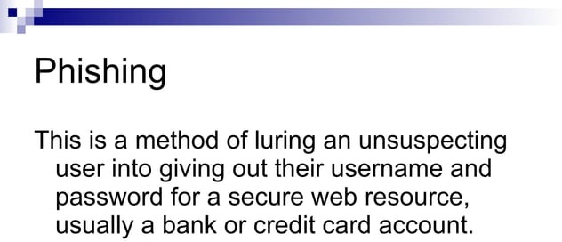

Slide 77
Demonstration

Slide 95
demonstration

